Slide 1
Group 6
Charlie Crewe, George Flude, Alex Polley and Callum Walsh.

Slide 2
Our goals & learning outcomes.
Goal: Use coercive monetisation techniques to generate revenue for a mobile game.
Learning outcomes
Establish constraints that keep the project on track, and maintains a consistent flow of design and management.
Able to realistically adhere to milestones and set deadlines for the project.
Gain an understanding of various monetisation methods used within the mobile game industry.

Slide 3
Pocket Pet Concept
Mechanics
Feeding creatures
Racing against diminishing values
Minigames
Game Loop
ENGAGE
Challenges
Keep pet alive
Obstacles
Time
CUSTOMISE
REWARD

Slide 4
Target Audience
7-12 year olds
Female
Impact of theme and art.
Appropriate themes

Slide 5
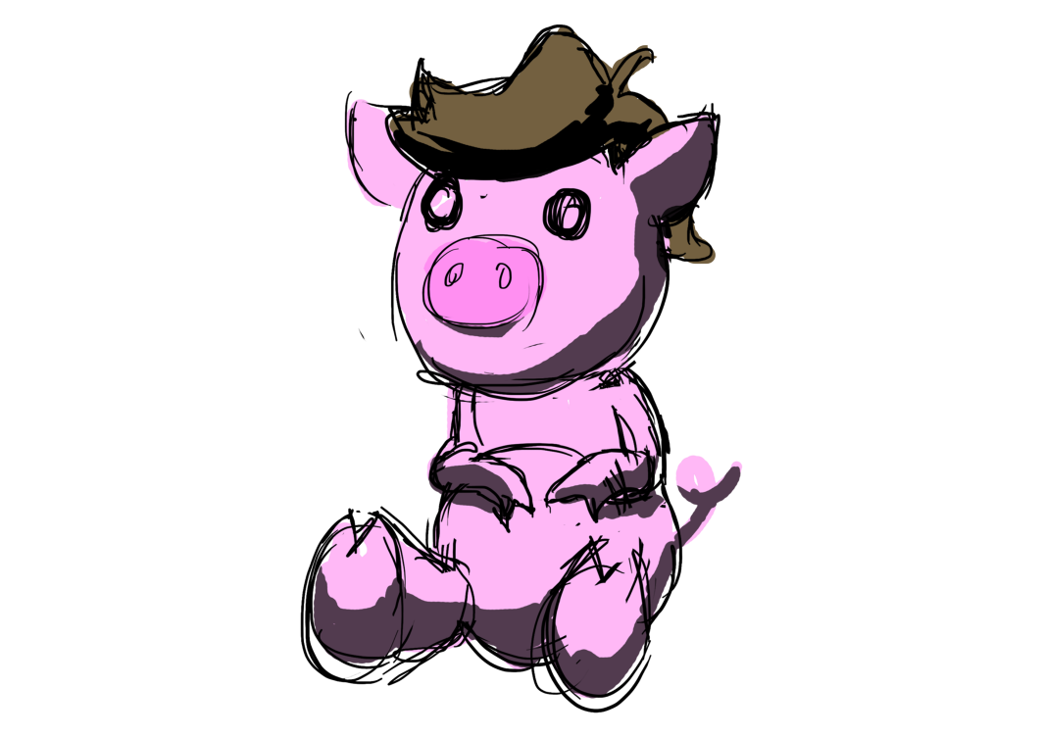
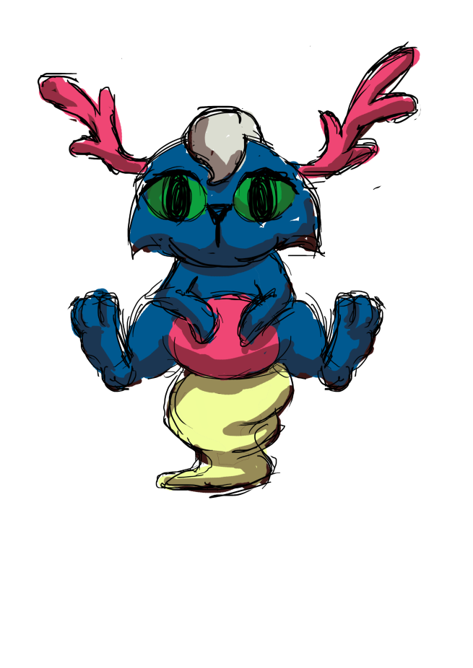
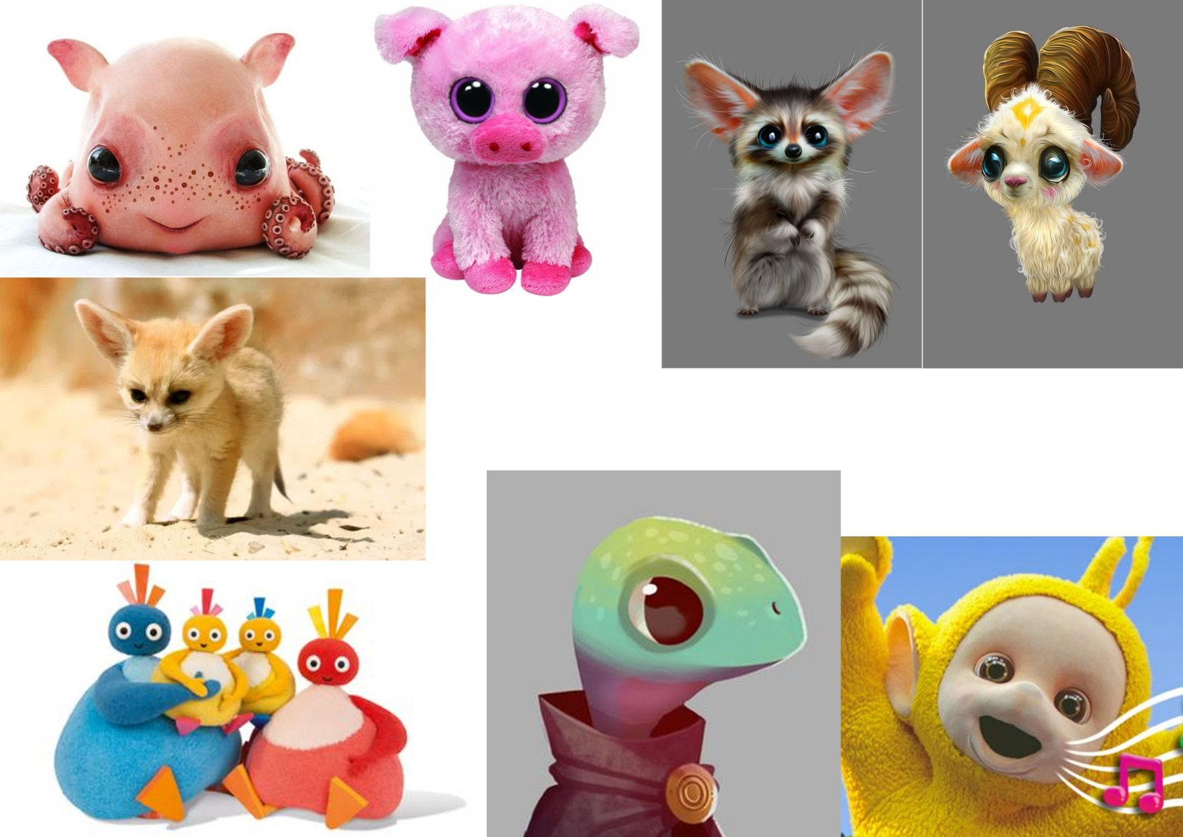
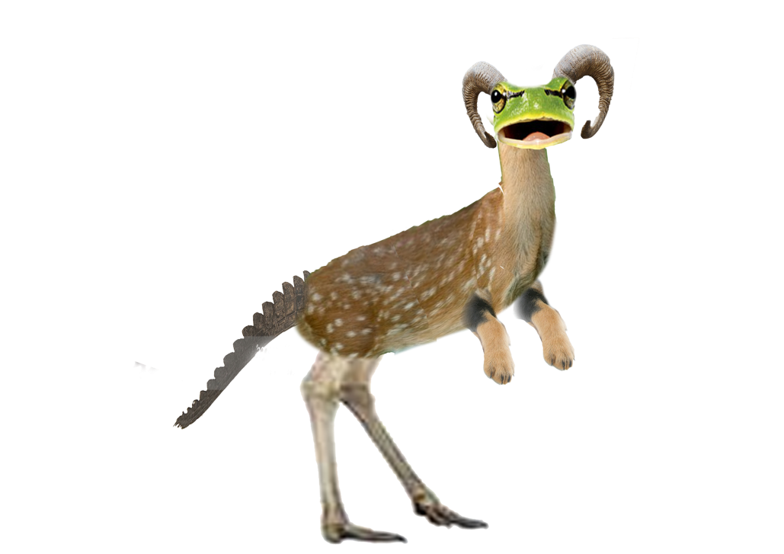
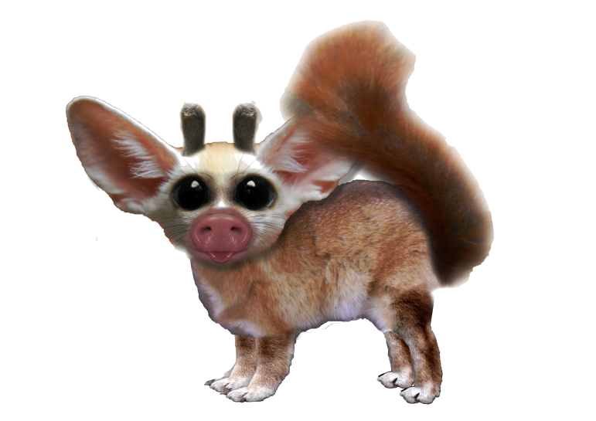
Mood boards

Slide 6
Monetisation
In game currency
Upgrades
Rewards
Using Schedules and contingencies
Variable
Fixed
Customisation
Clothing
Avatars
Gacha

Slide 7
Infinite runner concept
On the rails
Limits input needed
2D camera perspective
Challenges
Reaction time
Varying obstacles
Game Loop
PLAY
COLLECT REWARDS
UPGRADES

Slide 8
Target audience
18-25
Fast, short bursts of action
More susceptible to coercive monetisation techniques

Slide 9
Mood boards

Slide 10
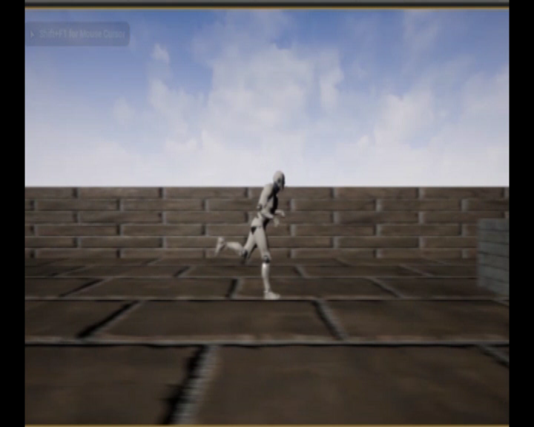
Prototype

Slide 11
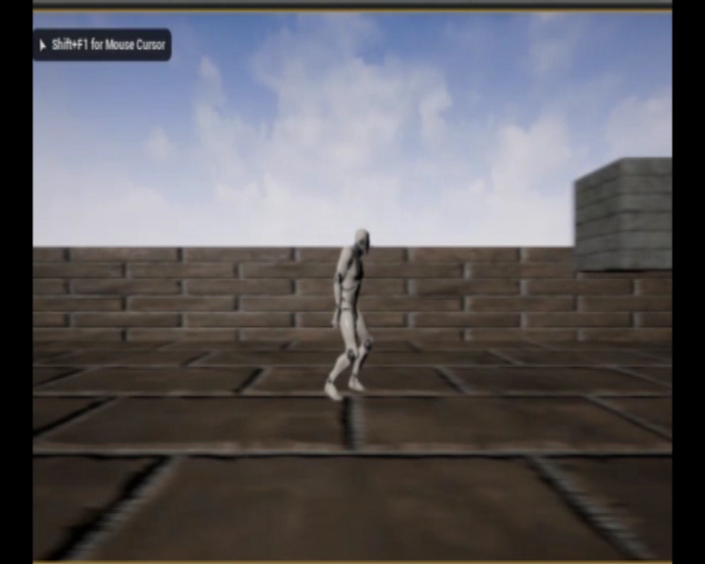
Prototype

Slide 12
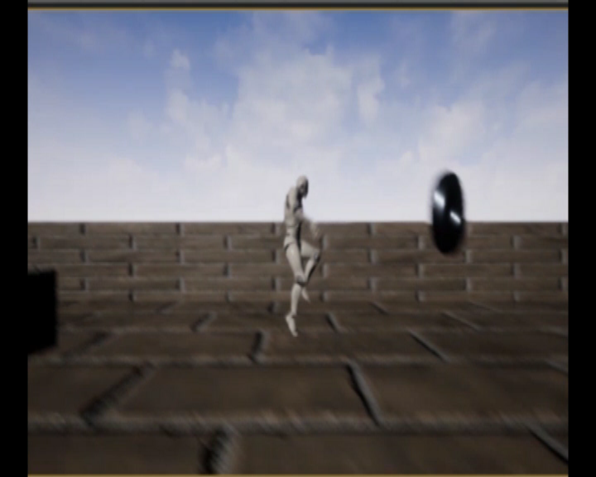
Prototype

Slide 13
Monetisation
Powerups
Pay to make gameplay easier
Personalisation
Customisation
Avatars
Unlockable/Mementos
Wallpapers
Achievements

Slide 14
Twitch based game Concept
Limit input to single tapping action
Short bursts of gameplay
Rewards that require in game currency to avoid removal if you die
Challenges
Timing
Puzzles
Attributes
Game Loop
REACT
UPGRADE
COLLECT

Slide 15
Target audience
18-25
Fast, short bursts of gameplay
Repetitive actions

Slide 16
Mood boards

Slide 17
Prototype

Slide 18
Monetisation
Rewards
Marketplace to sell items for in game currency
Customisation and Personalisation
Daily rewards

Slide 19
Questions?

